Slide 1

Water Quality Prediction with Machine Learning
Water quality monitoring plays a vital role in ensuring the safety and sustainability of our water resources. Machine learning offers powerful tools to analyze complex water quality data, enabling us to predict future trends and proactively manage water resources.

Slide 2

Problem Identification: Importance of Water Quality Monitoring
1
Ensuring Public Health
Water contamination can lead to serious health issues, impacting human well-being and economic productivity.
2
Protecting Ecosystems
Polluted water harms aquatic life and disrupts delicate ecological balance.
3
Supporting Sustainable Development
Clean water is essential for agriculture, industry, and overall economic growth.
4
Resource Management
Effective water quality monitoring enables informed decision-making for resource allocation and pollution control.

Slide 3
Data Collection: Sources and Types of Water Quality Data
Sensors and Monitoring Stations
Satellite Imagery
Historical Data
Remote sensing provides data on water turbidity, chlorophyll levels, and algal blooms.
Past records of water quality parameters, weather patterns, and human activities.
Real-time data on parameters such as pH, dissolved oxygen, and temperature.

Slide 4

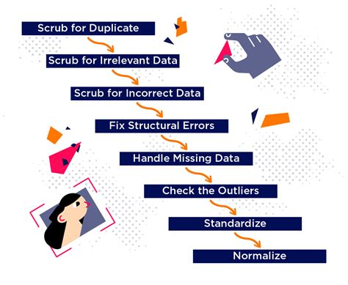
Data Preprocessing: Handling Missing Values, Outliers, and Normalization
1
Missing Value Imputation
Filling in missing data points using various techniques, such as mean or median imputation.
2
Outlier Detection and Removal
Identifying and removing extreme values that may skew the analysis.
3
Data Normalization
Scaling data to a common range to ensure all features contribute equally to the model.

Slide 5
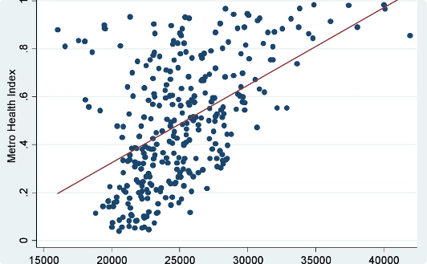
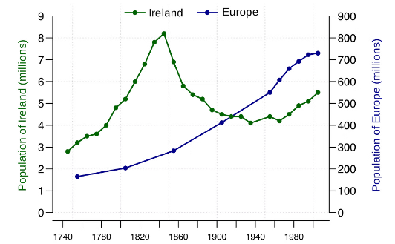
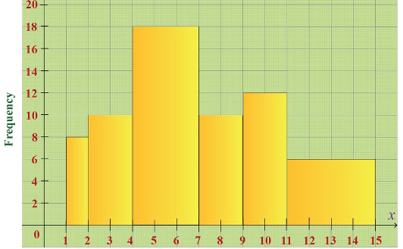
Exploratory Data Analysis: Identifying Patterns and Trends
Scatter Plots
Time Series Analysis
Histograms and Box Plots
Visualizing relationships between different water quality parameters.
Identifying seasonal trends, cyclical patterns, and anomalies over time.
Analyzing the distribution of water quality parameters and identifying potential outliers.

Slide 6

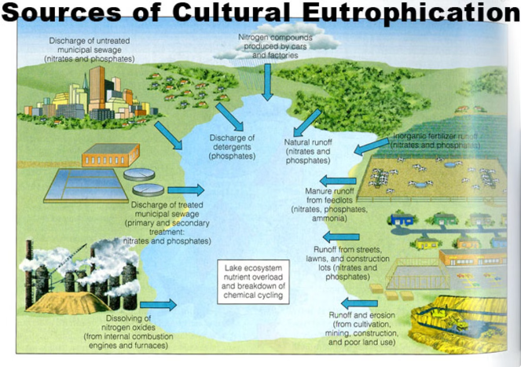
Hypothesis Development: Factors Influencing Water Quality
Factor
Impact on Water Quality
Industrial Discharge
Increased levels of heavy metals, chemicals, and organic pollutants.
Agricultural Runoff
Elevated levels of nutrients, pesticides, and fertilizers.
Urbanization
Increased wastewater discharge, sedimentation, and storm water runoff.
Climate Change
Altered precipitation patterns, higher temperatures, and increased drought frequency.

Slide 7

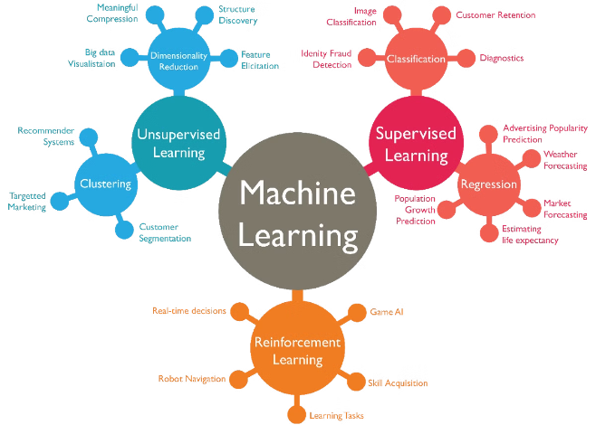



Solution Design: Machine Learning Algorithms and Techniques
Regression Models
Predicting continuous water quality parameters, such as pH or dissolved oxygen levels.
Classification Models
Classifying water quality into categories, such as "good," "fair," or "poor."
Deep Learning Networks
Analyzing complex relationships and identifying hidden patterns in water quality data.

Slide 8
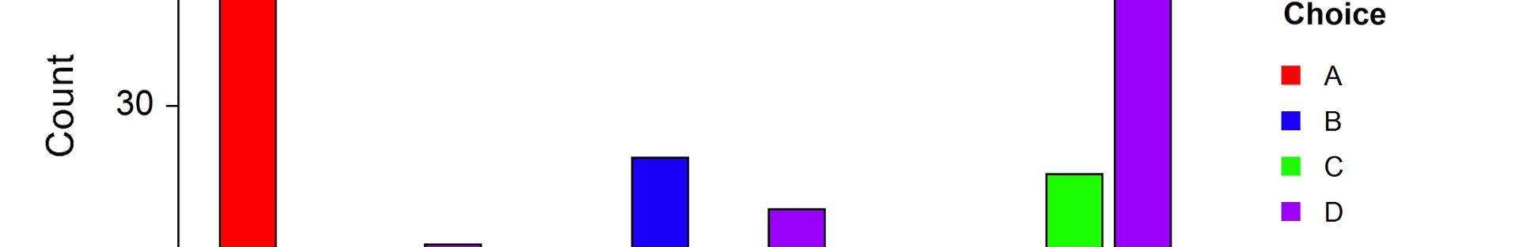
Model Training and Evaluation: Measuring Performance Metrics
Accuracy
Precision
The proportion of correct predictions made by the model.
The ability of the model to correctly identify positive instances.
Recall
F1-Score
The ability of the model to identify all positive instances.
A balance between precision and recall, providing a comprehensive measure of model performance.

Slide 9


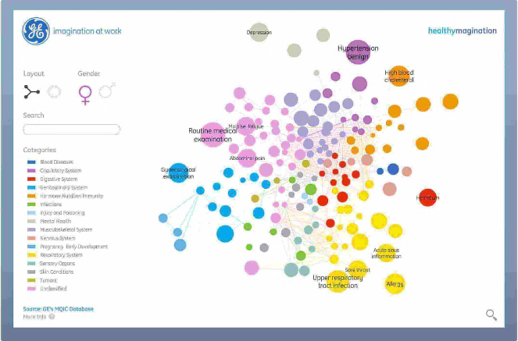


Data Visualization: Presenting Insights and Predictions
Interactive Dashboards
Visualizing key water quality indicators, trends, and predictions in a user-friendly interface.
Geospatial Mapping
Displaying water quality data on maps, highlighting areas of concern and potential pollution sources.
Alerts and Notifications
Triggering alerts when water quality parameters exceed predefined thresholds.

Slide 10


Conclusion and Future Recommendations
Machine learning has emerged as a powerful tool for water quality prediction, enabling us to make data-driven decisions and ensure the long-term health of our water resources. Continued research and development in this field are essential for addressing emerging challenges and promoting sustainable water management practices.

